Slide 1
Battelle Project Presentation
April 22nd, 2025
Kyle Tran

Slide 2
Agenda
Cuboid
Discussion of Changes Made
Challenges Faced
CVRF Viewer
Discussion of development process
Web App Design
Demo
Questions

Slide 3
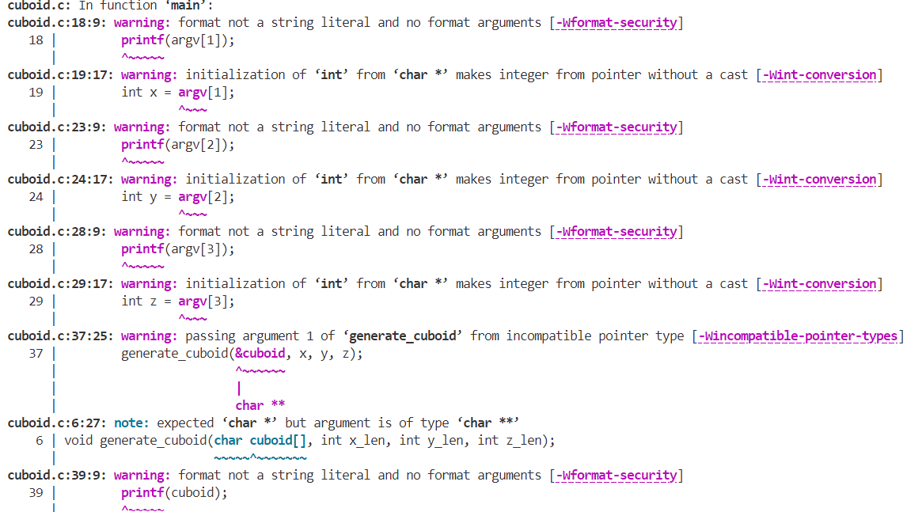
Cuboid
Requirements:
Program takes 3 numbers
No trailing whitespace after characters that make up cuboid
Changes Made:
Number of arguments
Input type (string vs int)
printf statements
Logic for generating cuboid

Slide 4
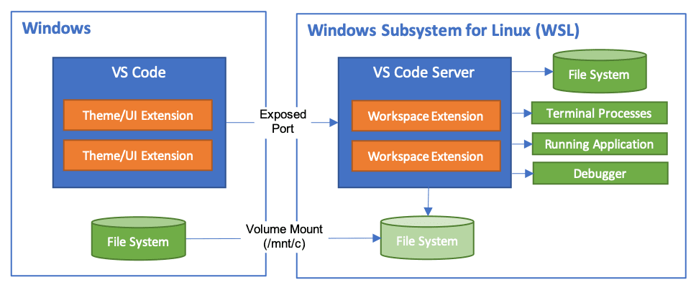
Challenges + Validation (Cuboid)
Operating on Windows OS
Installed Ubuntu and set up WSL (Windows Subsystem for Linux)
Needed Refresher on C
malloc / Memory Allocation
Pointers
https://www.w3schools.com/c/c_pointers.php
Compilation with gcc, looking for warning
Edge Cases:
More than 3 / Less than 3 arguments
Number dimensions, 0 < dimension < 10

Slide 5


CVRF Viewer
Requirements:
Vue 3 Web App
Ability to filter based on string match
Don’t include ** RESERVED ** records
Tool Stack: Vue 3 Web App, Tailwind CSS
Main Components to consider:
How to parse XML file?
How to implement filtering/sorting?
How to display CVRF vulnerabilities?
Backend or Database?

Slide 6
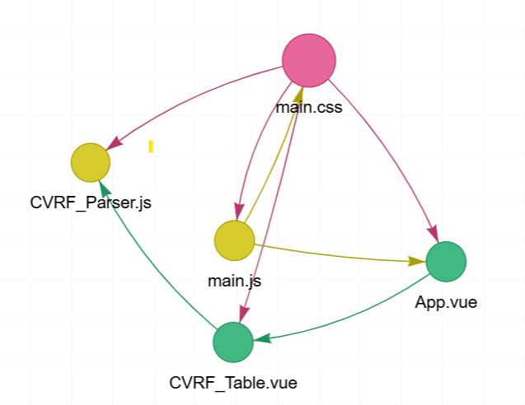
Web App Structure Diagram
App Components:
main.css
App.vue
main.js
CVRF_Parser.js
Contains parsing, sorting, and filtering logic
CVRF_Table.vue
Contains template/html for displaying UI

Slide 7
Challenges + Validation (CVRF Viewer)
Tailwind CSS 4.X Capability with Vue3 version
Looking at documentations/tutorials:
https://dev.to/osalumense/install-tailwind-css-v4-in-a-vue-3-vite-project-319g
Font/Color Not Working
Parsing the XML file
Making sure reserved entries not displayed
Using console.log to debug
Formatting
Pagination
Search Functionality

Slide 8
Thank You! Questions?

